Slide 1
Security Ontology
S Lalit Mohan

Slide 2
Agenda
Ontology
What
Why
Some more content.. 3-4 slides
Security Ontology (ies)
Usage
Sample
Show code examples
Include related queries
Links to Ontologies examples
Example of description logic and predicate logi
Approaches to maintain Ontologies
Ongoing Research

Slide 3
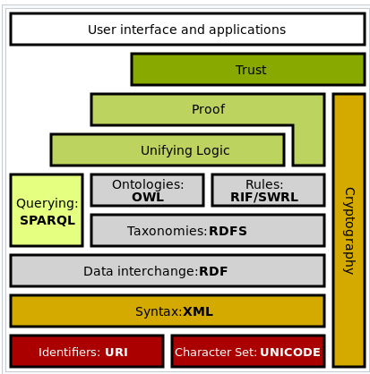
Semantic Web
Other Formats
SBVR
SKOS
Linked Data
Knowledge Graphs
GRDDL
PROV-Q
Our Interest
Notes:
Web 3.0
Semantic Web - Resource Description Framework .. that can be processed by machines
Simple Knowledge Organization System (SKOS)
Semantics Of Business Vocabulary and Rules (SBVR)
Gleaning Resource Descriptions from Dialects of Languages (GRDDL)
PROV-AQ: Provenance Access and Query
Essentially these are XML formats..

Slide 4
What is Ontology
Ontology - It is a philosophical study of being
W3C standard
Types of Ontology - Upper, Interface , Process and Domain
Notes:
The compound word ontology ("study of being") combines onto- (Gr. ὄν, on,^{[2]} gen. ὄντος, ontos, "being; that which is") and -logia (Gr. -λογία, "logical discourse"). See classical compounds for this type of word formation
Parmenides
Ontology is an aspect of the Samkhya school of philosophy from the first millennium BCE.^{[11]} The concept of Guna which describes the three properties (sattva, rajas and tamas) present in differing proportions in all existing things, is a notable concept of this school
Upper ontology: concepts supporting development of an ontology, meta-ontology
Domain ontology: concepts relevant to a particular topic, domain of discourse, or area of interest, for example, to information technology or to computer languages, or to particular branches of science
Interface ontology: concepts relevant to the juncture of two disciplines
Process ontology: inputs, outputs, constraints, sequencing information, involved in business or engineering processes

Slide 5
How is Ontology different than a
Folksonomy
A collection of terms (tags) to enhance categorization
Glossary
List of terms with definitions and explanations in natural language
Controlled Vocabulary
An enumeration of terms defined to be shared and reused
Hierarchy
A nested set of terms
Taxonomy
A hierarchy that uses “is-a” relation
Meronomy
A hierarchy that uses the “part of” relation
Classification
A set of categories in which objects are grouped into

Slide 6
Why Ontology?
Consistency – determines whether the ontology contains contradictions
Satisfiability – determines whether classes can have instances
Subsumption – are all instances of one class also instances of another class?
Classification – repetitive application of subsumption to discover implicit subclass links between names classes
Realization – find the most specific class that an individual belongs to
Notes:
Versioning !
Provide a formal specification of domain knowledge
Provide a classification of domain entities
Develop a common understanding of the entities in a given domain
Enable reuse of data and knowledge
Enable domain discovery

Slide 7
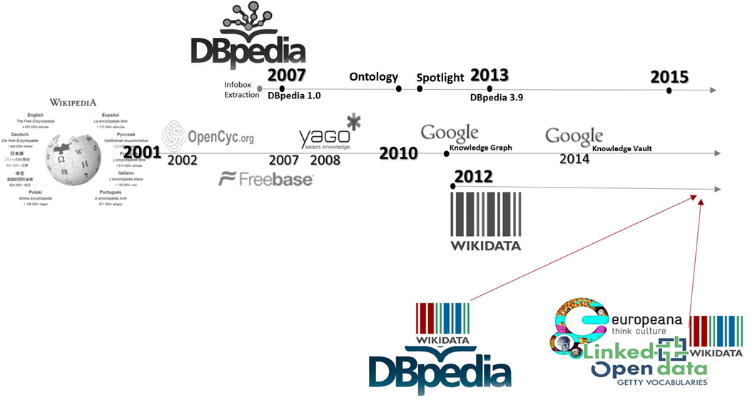
Wikipedia → DBPedia
Content from Wikipedia is available as Ontology

Slide 8
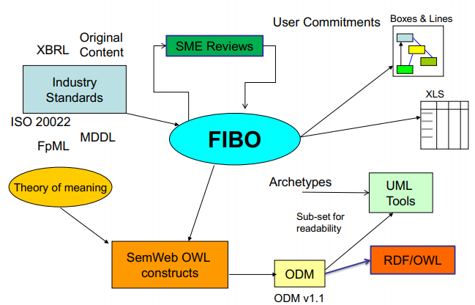
Financial Industry Business Ontology

Slide 9
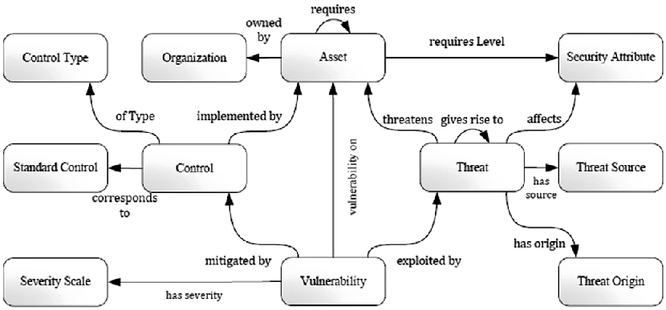
Upper Security Ontology
Disaster / Accidental
Human / State

Slide 10
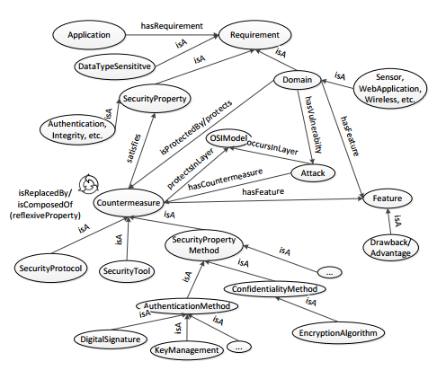
Attacks & Countermeasures Ontology

Slide 11
Some Constituents of Ontology
Domain and Range
Class
SubClassOf
DataType
Object Property
Reflexive, Irreflexive, Transitive, Symmetric and Asymmetric
Cardinality
Data Property
Literal
Joints and Disjoints
SubPropertyOf
UnionOf, IntersectionOf
Assertions

Slide 12
Reasoning from Ontology
SPARQL
PREFIX foaf: <http://xmlns.com/foaf/0.1/> SELECT * WHERE { ?person foaf:name ?name . ?person foaf:mbox ?email . }
SWRL
Person(?x), hasParent(?x, ?y), hasParent(?x, ?z), hasSpouse(?y, ?z) -> ChildOfMarriedParents(?x)

Slide 13
Uses of Ontology in Security
Elicitation of Security Requirements
Policy and Standards Validation and Audit
Information Security Risk Management
Generation of IT Metrics
Vulnerability Assessment
Simulating Threats to Corporate Assets
Threat Intelligence / Information Sharing
Build Knowledge Base (TBox and ABox)
Notes:
Softer Learning - Deeper conversation with your developers and software providers
Description Logics

Slide 14
Ontology Management
Creation
Enrichment / Evolution / Maintenance
Merging / Alignment
Methods
Domain Experts
Direct
Collaboration
NLP and Text Processing
LSTM (Deep Learning)
Measurement
Completeness, Consistency and Correctness – Stanford Chimaera
Similarity
Reasoning Flexibility
100+ metrics

Slide 15
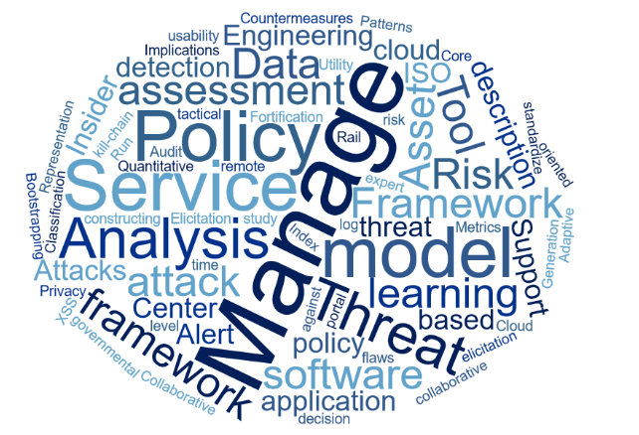
Ongoing Research in Security Ontology

Slide 16
STIX and TAXII ????

